Slide 1

TransLoc Usability
Report
Bailey Roberts, Irena Brain, Amrut Dagade, Vernnica Tseng, Allison Beatty

Slide 2
Overview
01
Background
02
Methods
Introduction
Goals
Usability test design
Test environment, equipment and materials
Task list and description
03
Data
04
Assessment
Collection
Analysis
Results
Recommendation
Conclusion

Slide 3
Background
Transloc
Microtransit & On-Demand Services
Fixed Route Services
Transloc serves multiple types of entities, including:
Cities
Transit agencies
Universities
Airports
Corporate campuses
Healthcare systems
Operator partners
Notes:
Bailey

Slide 4
Evaluation Goals
Are users able to understand how to plan single-route trips?
Are users able to understand how to plan multi-route trips?
How long does it take a new user to plan a route for a future time?
Can a user identify the exact time a bus will arrive at their stop?
Can users add or remove route providers successfully using the “settings” tab?
Notes:
Bailey

Slide 5
Method - Test Design
Goal: Assess effectiveness and intuitiveness of TransLoc app.
The team directly observed and collected data about error and success rate, quantity data on participants’ performance, and qualitative data on participants’ experience using the app.
 | Time | Participants will
Pre-Test Arrangements | 5 minutes | - Review and sign non-disclosures and recording permissions. - Fill out a questionnaire to understand participant’s prior experience with TransLoc and how familiar they are with TransLoc.
Tasks | 30 minutes | - Perform 3 tasks on TransLoc while thinking-aloud in the test environment.
Post-Task Questionnaire | After each task | - Answer 3 broad questions to collect preference and other qualitative data.
Post-Test Survey | 3 minutes | - Follow up on any particular problems that came up for the participants.
Notes:
Vernnica

Slide 6
Method - Test Environment, Equipment, and Materials
Utilized controlled setting to evaluate the usability of the Transloc app
Testing setting: UNC Manning Hall classroom
Team members needed each session:
1 moderator
1 observer
1 scribe
Test Environment
iPhone (A) - for participant
connected with high-speed Internet
Transloc app properly installed and set up
Zoom session set up for screen sharing
Laptop (B) - for observer
Zoom session connected to iPhone (A) for screen recording
Laptop (C) - for scribe
Participants folder properly set up and ready to take notes
Laptop (D) - for moderator
Test script downloaded
Printed copy of script - for backup
Test Equipment and Material
Notes:
Tried to utilized controlled setting
Done in Manning hall classroom with 1 moderator, 1 observer and 1 scribe
3 laptops
For observer and to control screen recording
For scribe to take notes
For moderator have test script and

Slide 7
Method - Task List
Task 1 | Using the TransLoc app, find a route from Weaver Street Market in Carrboro, NC to Manning Hall on UNC’s campus by 4:00pm Tuesday.
Task 2 | Using the TransLoc app, find a route from the UNC Hospital in Chapel Hill, NC to the Friday Center Park and Ride Lot in Chapel Hill, NC at 9:00pm on Tuesday.
Task 3 | Using the TransLoc app, find a route from UNC’s campus in Chapel Hill, NC to Duke’s Campus in Durham, NC departing at 4:00pm on Tuesday.
Notes:
Irena
Tasks were chosen based on:
Difficulty: wanted to give the users an easier task first so they are less likely to be frustrated
Commonality: chose tasks that a typical user would likely encounter
Diversity: diversity of times, locations, and number of routes
Versatility: multiple different ways to complete each task, helps us understand why different users might approach tasks differety
Succinct: clearly expressed to the user what they must do

Slide 8
Data Collection
Types of data collected
Mixed methods
Questionnaires (test questions)
Open-ended:
Free-form
Neutrally worded
Qualitative
Closed-ended:
Interval data
Semantic differential (rating attitude)
Quantitative
How data collected measures study goals:
Experience
Efficiency
Completion
Notes:
Allison

Slide 9
Data Collection
Recorded by test participant:
Qualtrics questionnaires (pre- & post-task)
Demographic (age group & gender identity)
Prior familiarity with using public transit, using Transloc app (qualitative free response + interval)
Experience of usability test & feelings about using the app (interval)
User-suggested changes, input on app (qualitative free response)
Notes:
Allison

Slide 10
Data Collection
Recorded by scribe & observer:
iPhone screen recording (Zoom)
Think-aloud audio (Zoom)
Per each task:
Scribe’s notes (shared document)
Time-to-completion (stopwatch)
Semantic differential rating scales (ease of task, satisfaction with Transloc)
Asked by moderator/presented on print-out and recorded in shared doc by scribe
Open-ended questions reflecting on task (audio recording, shorthand scribe’s notes)
Open-ended final thoughts, questions, and concerns (audio recording, shorthand scribe’s notes)
Notes:
Allison

Slide 11
Data Collection
Ethical considerations
Consent form for study participation & think-aloud audio recording
Participant privacy & anonymity
No self-identifying information, i.e. residential or workplace addresses
Collection tools used & UNC IRB policies
Qualtrics
Zoom
All data stored in password-protected drive shared only within Transloc team
All computers used by Transloc team members have password-protected and encrypted hard drives
Notes:
Allison

Slide 12
Data Analysis
We used Qualitative method to analyze the data
Used surveys, video recording and notes
We found three issues of which were rated as high critical and the other as low critical
Features that needs to kept stable through out
Substantial scope for enhancing both the app and the overall user experience.
Notes:
– few good findings of the app, these are features that needs to be stable and keep improving the experience. () – There is room for improvement in both the app and the overall user experience

Slide 13
Data Analysis - Findings
Issues encountered while performing tasks —
Verifying routes
Search bar confusion
Multiple times changed, but still difficult to locate on screen.
Checking the map to find the start location and not clear with the starting location
Notes:
Verifying if the route is correct or not.
The search bar is confusing because it is not clear whether to input the starting point or the destination “ search bar on the app to be unclear whether they are searching starting point or their destination.it was difficult could not differentiate between the two options and was unsure how to input the correct information.

Slide 14
Data Analysis - Findings
Finding Pre-task survey : Low – Although some users who are already familiar with public transportation face challenges while using the app, can be improved to provide a more seamless and user-friendly experience. – Many tasks were successfully completed indirectly, where users deviated from the expected path or took alternative routes to complete them.
Finding Post-task survey : Critical Was it simple to use the app : 33% – agreed 67% – disagreed Any issues with functionality? 67% – faced 33% – did not
Will you keep using app in the future? 33% – Not sure , 33% – May or May not , 33% – May use.
Notes:
Was it simple to use the app : 33%(somewhat agreed ) to be easy to use, but they may have encountered some minor difficulties and
67% (Neither agree nor disagree) do not feel strongly that it was either simple or complicated to use
any issues with the Transloc app's functionality? 67% possibility they did not encounter any issues, depeding on other factors 33% tells that the issues were significant and had a noticeable impact on their experience using the app. Will you keep using the Transloc app in the future? 33% (Probably not) - encountered issues that have led them to doubt the app's usefulness or reliability . 33% (Might or might not) — had mixed experiences with the app or have not fully decided whether it meets their needs . only 33% (Probably yes) — They have had a positive experience with the app or find it useful and reliable.
Experience any unforeseen changes or delays while you were traveling?
only 33% (Probably yes) — most likely encountered some unexpected changes or delays during their trip 67% (Definitely yes) : users encountered unexpected changes or delays during their trip without any doubt

Slide 15
Results - Executive Summary
Findings and results organized by research question and evaluation goals
Key findings
Participants are able to complete tasks, but find interactions somewhat confusing
Barrier to entry when using the app
Multiple unused/unseen features and options throughout testing sessions
Wording/phrasing issues that causes confusion when using certain features
Notes:
Irena
Explain the results of your analysis, prioritizing the findings as appropriate
May organize this section by task, metric, or analysis type (depending on your goals)
May include comparisons across tasks (depending on your goals)
• One-page summary of key findings and recommendations • 30 second – 2 minute hallway conversation with a key stakeholder or an executive
The results of a usability test are not merely tables of data and lists of issues. The results of a usability test comprise the discoveries made while observing real users performing realistic tasks using a product. Results document the data you collected and analyzed. Findings are inferences you and your team draw from the observations you have made along with analyzing the data.
Findings are often expressed in headline fashion or one-sentence statements that encapsulate the essence of the usability issue. They are the centerpiece of the report. For example, ‘‘The ‘Go’ label did not suggest ‘refresh’ or ‘reload’ to participants.’’
1. 2. 3. Write out the ﬁndings. 4. Expand the discussion of each of the ﬁndings with narrative, participant quotes, and illustrations (such as screen captures). Go back to the beginning of the results section of the report to write a section describing global ﬁndings and overall conclusions.

Slide 16
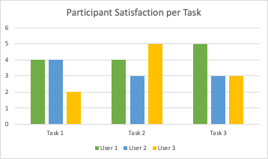
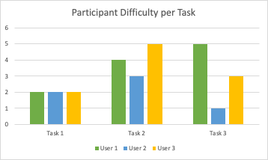
How do users feel when interacting with the current application?
Q1
1 = very unsatisfied
5 = very satisfied
Positive:
“Likes that real time tracking got added back”
“Free to use”
“Pretty simple”
“Don’t have to use third party”
“ I feel like [TransLoc] has all the information”
Negative
“Not intuitive”’
“Frustrated with TransLoc for a long time”
“They are doing the bare minimum, there is lots to be desired”
“Confusing”
“Need to do more detailed searching”
1 = very difficult
5 = very easy
Notes:
Tell the story
• Describe problem in context: • User’s context • Task context • Screen captures and/or video clips
• Identify the cause of the problem • Hard to fix without identifying cause • Connect to guidelines and/or heuristic violations
• Evaluate impact of the problem • Severity rating
• Balance positive and negative findings (“areas of opportunity”)

Slide 17
Are users able to understand how to plan single and multi-route trips?
Q2
Broad answer: yes
Some initial/continued confusion was common
100% task completion
When asked about planning a trip, “it was hard but [the app] was very useful”
Increased understanding and familiarity of app at testing continues
“... getting a better hang of the app”
“... feel like it is very easy now that I have used it before”

Slide 18
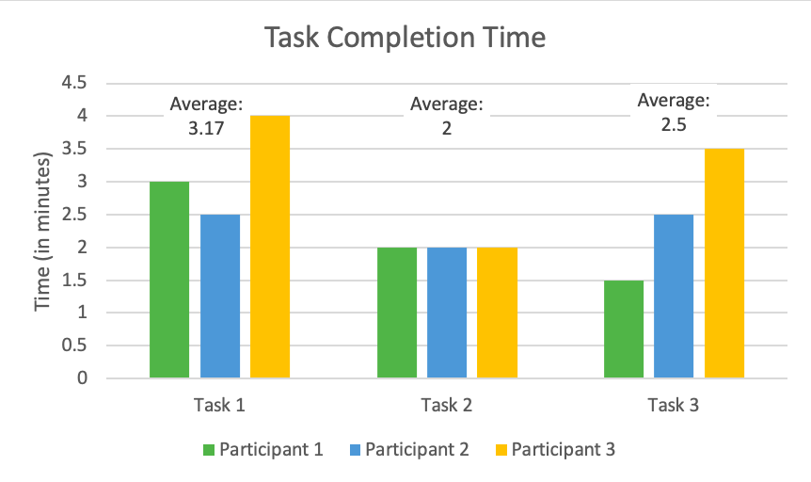
How long does it take a user to plan a trip?
Q3
Notes:
Average total: 2.5
First task was designed to be easiest, last was designed to be most difficult
First task might have learning curve

Slide 19
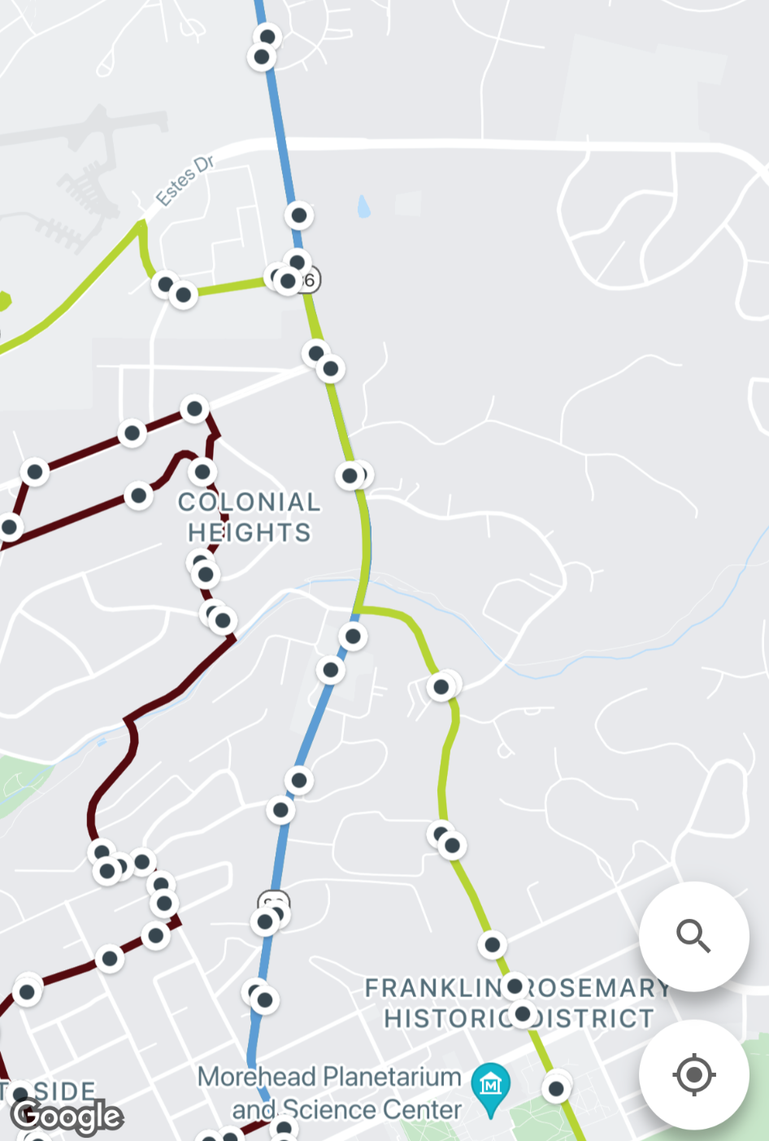
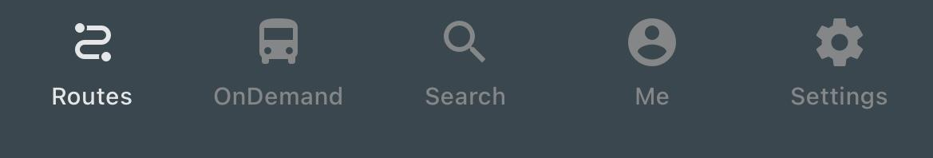
How easily/successfully do users use different sections of the app?
Q4
“Search”
Participants primarily used “search” tab to complete tasks
Search tab useful when knowing specific start/end locations
“Routes”
Found “routes” tab to be difficult to use
“Show which way the routes were going”
“OnDemand”, “Me”, and “Settings” not utilized during testing

Slide 20
How do users feel about app features?
Q5
Search for route feature
“Where to?” placeholder did not suggest destination to participants
All participants experienced confusion about how to type start and end locations
Participant notes it is missing reverse start and destination feature
Schedule route feature
1 of 3 participants noticed and utilized feature
“Search for estimated arrival time instead of leaving time”
Scheduled time vs time for bus to come is not accurate
Available routes feature
Participants liked this feature
Being able to see available routes and choose which one is better
Shows where you are on the map, shows how long you have to walk
“Doesn’t really give information about the routes”
Zoom features
Once a route is selected, map view zooms to entire US
“Re-center” button not initially available, appears after touching map
“When it shows the routes, it should start zoomed in “

Slide 21
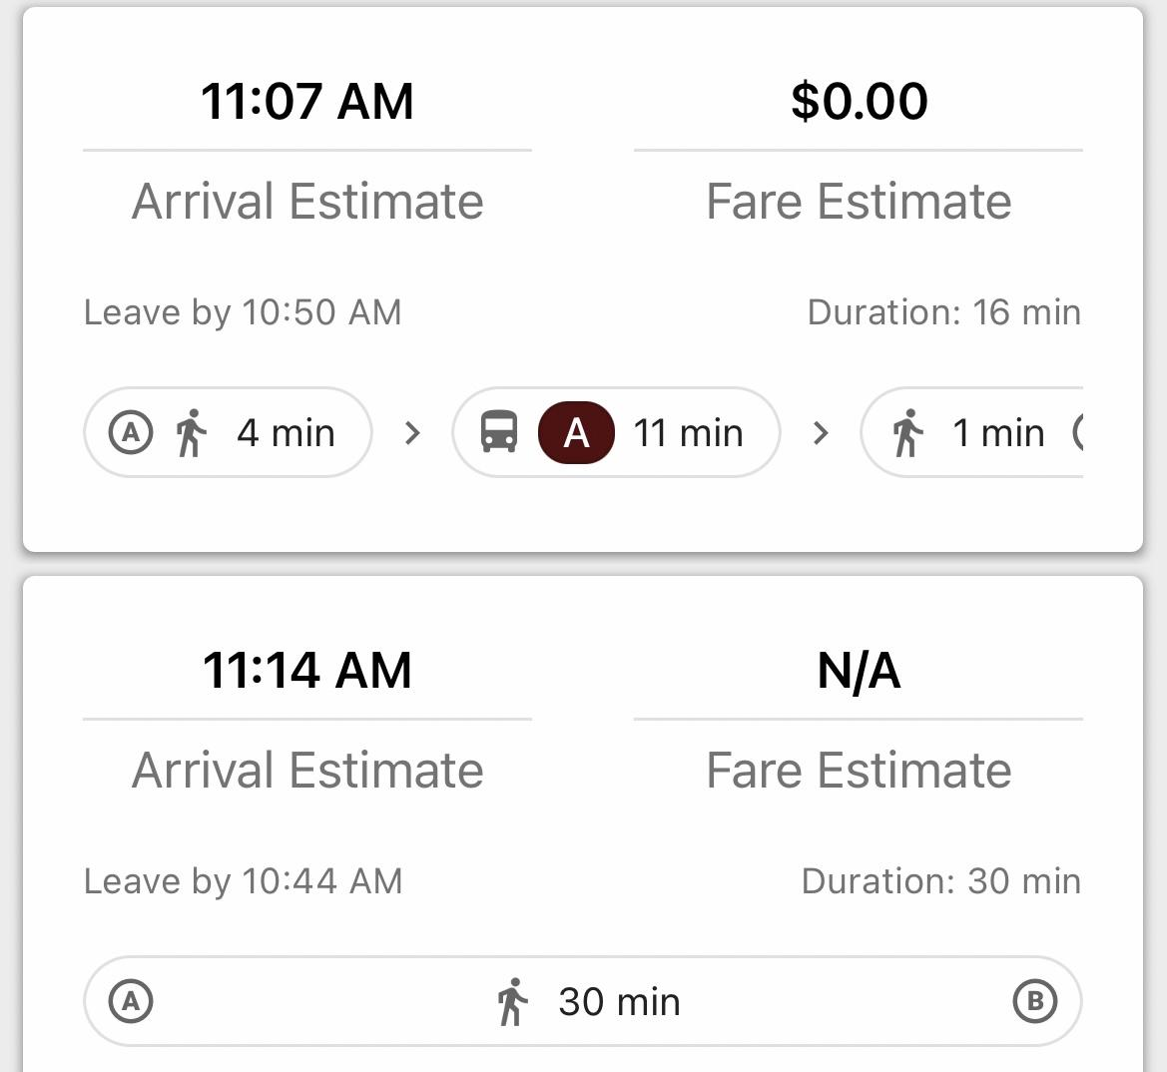

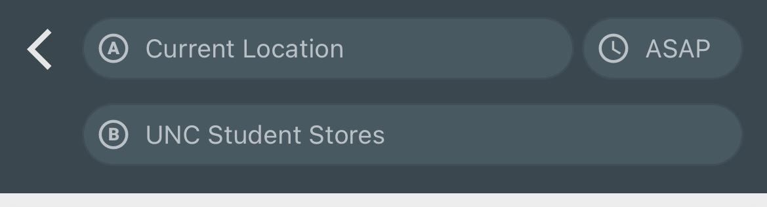
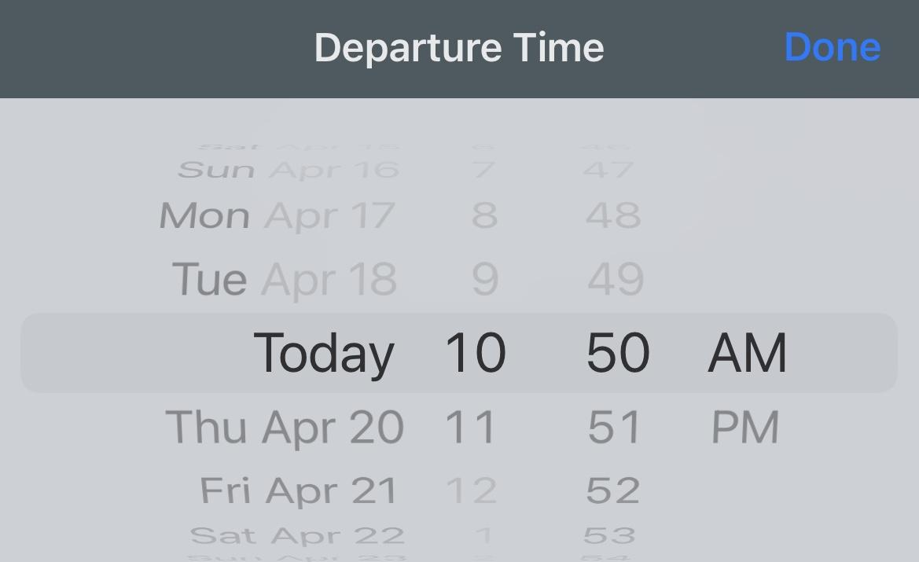
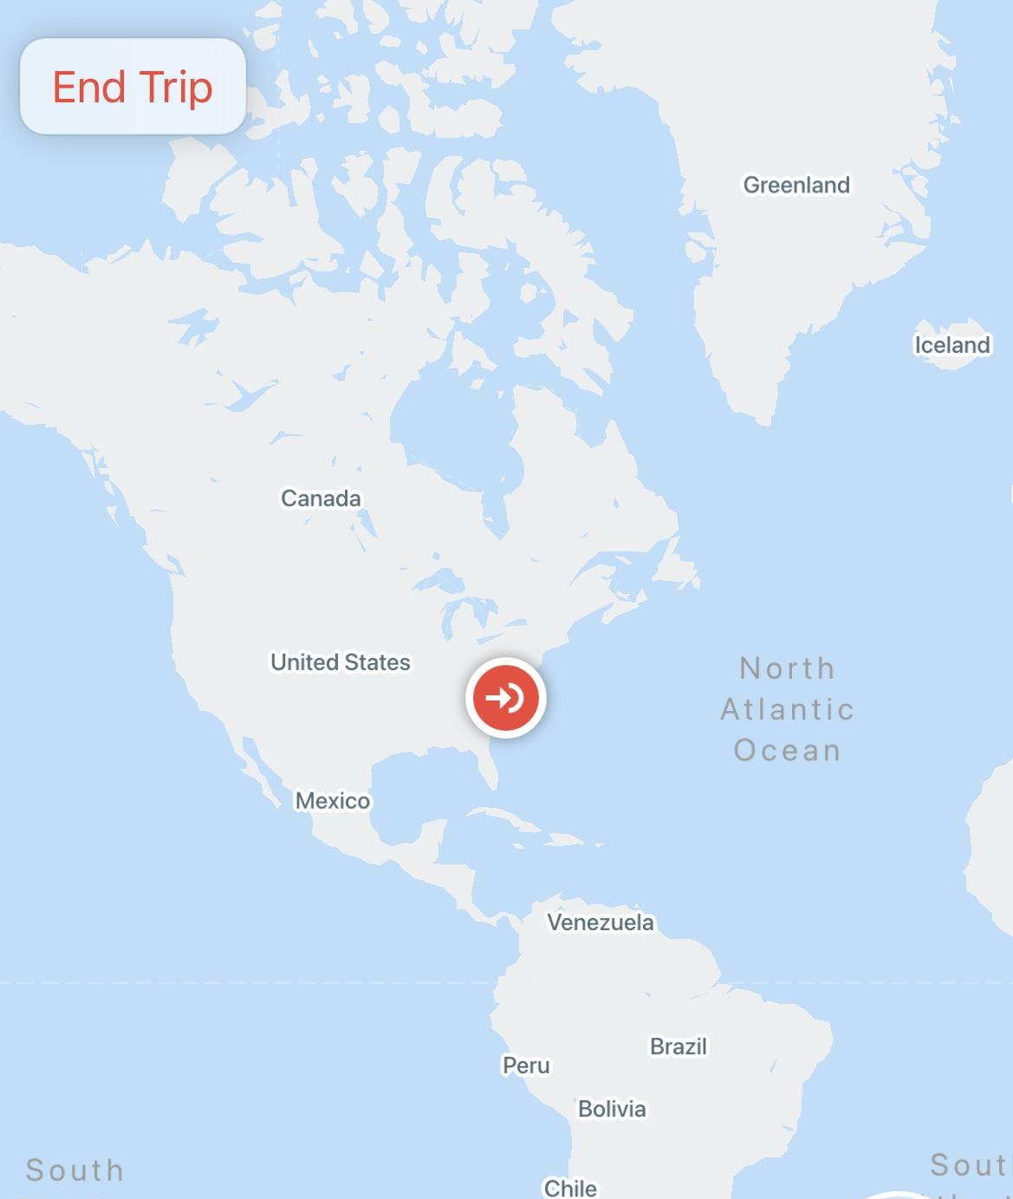
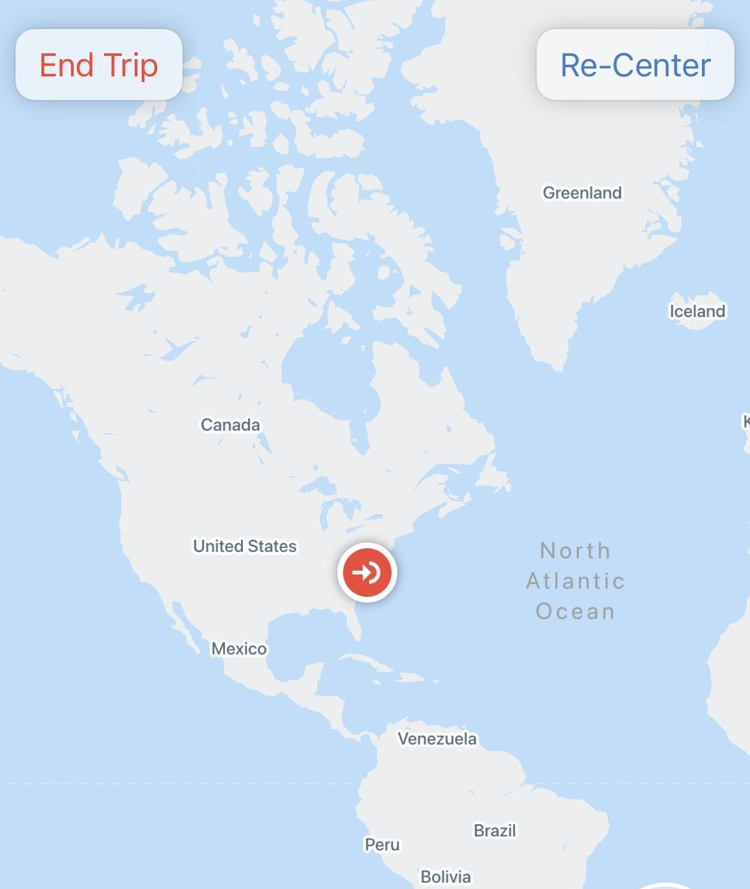
Available routes feature
Search and schedule route feature
Zoom feature

Slide 22
Recommendation - 1
Increase contrast between features
Don’t assume starting location as current location
Clarify “ASAP” feature as departure-time feature
Notes:
Bailey

Slide 23
Recommendation - 2
Integrate route preview via map function before route confirmation
No need for departure, duration, and arrival time in preview.
Restructure current route preview slider to include entire route in compact, clear way.
Notes:
A combination of the routes and search tabs would be ideal.

Slide 24
Recommendation - 3
Automatically zoom to fit entire route in map view
Increase size of “Re-Center” and “End Trip” buttons
Increase contrast of buttons versus the map colors

Slide 25
Conclusion
Participants are able to use the map - the usability issues are not a huge barrier but users are frustrated interacting with the app.
The app is usable but has a significant learning curve, creating barriers to entry. Once these barriers are overcome, the app is usable, but many users do not want to take the time to learn how to use the app rather than using a different transportation app, like Google Maps.
Transloc does a good job exhaustively covering public transit options, despite being out-competed by other apps with better usability.
With our suggested changes, TransLoc has the potential to be a helpful and more intuitive app!
Notes:
Allison

Slide 26
Questions?

